Slide 1
Discount Process Is The Problem
An “Off-Market Approach”
Jon Spain (20 Jul 2025)
www.discrate.com

Slide 2
disclaimer
views expressed are entirely personal
thanks are due to those who discussed issues over time
… and to those who have refused to engage
in no way endorsed by UK actuarial profession - yet
actuaries claim to understand risks
  probabilities rarely (if ever) disclosed to DB pension clients
DB pension schemes tied to discounting
  required by regulators
  doesn’t mean discounting must be useful for long term
actuaries and TPR responsible for stupid regulations
  look at 2022 LDI debacle (move on, nothing to see)

Slide 3
agenda
main points
why does this matter?
following evidence is essential
single numbers presented as “results”
the long term – is there one? estimating returns?
forecasting approaches
simple financial contracts
  various metrics considered
surplus refunds - again
key takeaways

Slide 4
main points
we don’t know long-term future - we need assumptions
today doesn’t represent all we know
  we can look back at the past to see what we think happened
  we also need to be very careful about using the past
prudence only identifiable from best estimate
future complexity “poorly” captured by single numbers
  … which is where discount process inexorably leads
  no illiquidity information (except at assumed final point)
appropriate discount rates are very hard to specify
… making discount process inappropriate for long-term
huge concentration on risk - without reward recognition

Slide 5
why does this matter?
UK DB pension scheme funding inefficiently controlled
  insurance companies (life and general) quite different
data (April) below from Pensions Regulator Purple Book
  private sector DB pension schemes (not public sector)
in 2006, estimated 7,751 schemes (14.0 m members)
in 2021, estimated 5,220 schemes (9.7 m members)
in 2021, scheme assets still stood at £1.7 trillion
  even after many liability transfers during 15 years
  far lower in 2024 (£1.2 trillion) after LDI crisis
required assets assessed under discount process
  … which is the underlying problem

Slide 6
brief UK DB history
from 1978, many more DB schemes set up (SSPA 1975)
accrued service relatively short, insignificant guarantees
main funding target was smoothed contribution rate
  welcomed by sponsors and trustees
assets also smoothed (mainly Heywood & Lander 1961)
benefit guarantees became increasingly significant
  preservation (1985), CETVs (1986), pension increases (1997)
dividend tax relief reduced in 1993 and removed in 1997
stringent corporate pension accounting (FRS17/IAS19) early 2000s saw equity markets plunge & MtM used
TPR became all-powerful from 2005 (that worked well)

Slide 7
hugely severe DB economic impact
how could we even have guessed how much in advance?
UK DB employers’ contributions (private sector alone)
  15 years [2009/Q2– 2024/Q3, 2 quarters missing] {ONS}
  MQ5 series was replaced, hence missing data
  total paid £436.3b (special £197.1b, 82% of normal)
suppose discount rate under-estimated by 1.5 % pa (mix)
  can easily reach 1.0 % pa from inflation (www.ukrpi.com)
implies at least 30% difference in capital value
so at least £131b (private sector) misallocated in UK
  my personal estimate, choose your own yield adjustment

Slide 8
following evidence is essential
actuaries (financial scientists) need to follow evidence
  always needs to be checked (complete? robust? …)
  no evidence that financial economics useful for long-term
evidence available must be interpreted - as experts
  otherwise, contributing very little indeed
interpretation is subjective, not objective
  room for expert judgment (Gil Grissom, Nikki Alexander)
nothing wrong with subjectivity, so long as …
  independent (not merely too common groupthink)
  cogently fully explained
  stakeholders empowered to understand potential outcomes

Slide 9
single numbers presented as “results”
single numbers are not appropriate results
… for representing many future uncertainties
  NYU Stern (1977) & Z/Yen (2012)
  Simon Carne’s SIAS paper (2004)
especially when single number never fully specified
  mean? median? mode? specified percentile?
we should be looking at multi-dimensional results
  with confidence intervals (deterministic approach fails)
  aiming at avoiding “fog of certainty” (actuarial noise)
  being able to recognise lack of liquidity in advance

Slide 10
what is discount process?
discounting principle known for over 2 millennia
  only adopted for longer-term finance in late 18th century
suppose precise return of 3 % pa for next year is certain
  103 due in a year’s time can be financed by initial 100
converting future cashflows to present
  discount rate inverse of investment return, not just abstract
  used by actuaries, accountants, project managers, scammers
we don't live in such a secure financial environment
  lack of certainty, much longer periods, assets not just cash
future unknowable => no uniquely correct discount rate
  liquidity problems not identifiable in advance

Slide 11
what is “mark-to-market” (MtM)?
“realistic appraisal of current financial situation”
market may sometimes appear illogical
… implying that opportunities exist for profits
markets are run by traders
  traders decide where THEY want to be (pricing) NOW
long-term funding depends upon long-term future
  if there is one (always needs to be considered)
many possible alternatives (labelled “off-market”)
why sub-contract L-T assumptions to S-T traders?

Slide 12
is there a long-term?
predators exist
  private (internal or external)
  public (regulators)
how much long-term confidence can there be?
  for trustees, members, sponsors, policyholders …
essential for issues to be discussed in depth
stakeholders entitled to follow own views
crucial that agreed approaches are fully documented
  do “SIP” and “SFP” really cover long-term issues (DB)?
equity risk premia (history and likelihood)

Slide 13
long-term risk premia
over rolling periods of 15 years
mean equity return minus mean bond return
equity return partly capital and partly income
  also true for bonds but variability lower
long-term equity return components
long-term equity risk premia (adjusted capital growth)
likelihood of equity risk premium (random numbers)

Slide 14
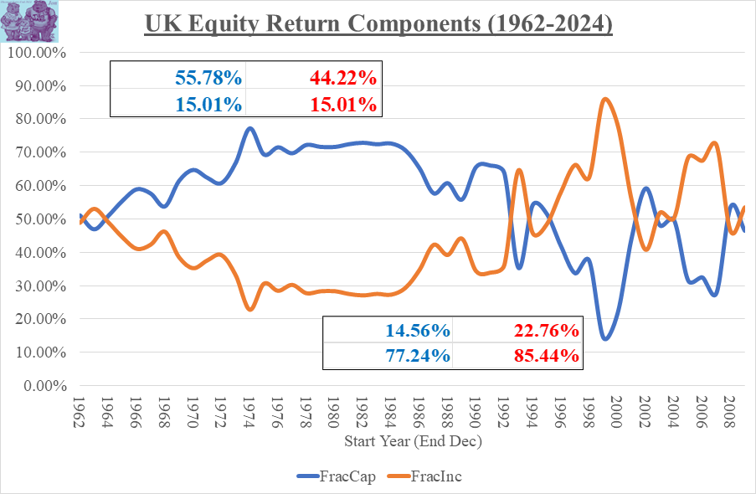
equity return components (1 of 2)
periods of 15 years (data 1962 to 2024)

Slide 15
equity return components (2 of 2)
example : overall period of 15 years 1962 to 2024
equity return total 10.95%
equity return capital 05.60%
gilt return total 06.14%
if only 50% capital growth had been achieved …
  equity return reduced by 2.80%
  equity risk premium falls from 4.81% to 2.01%

Slide 16
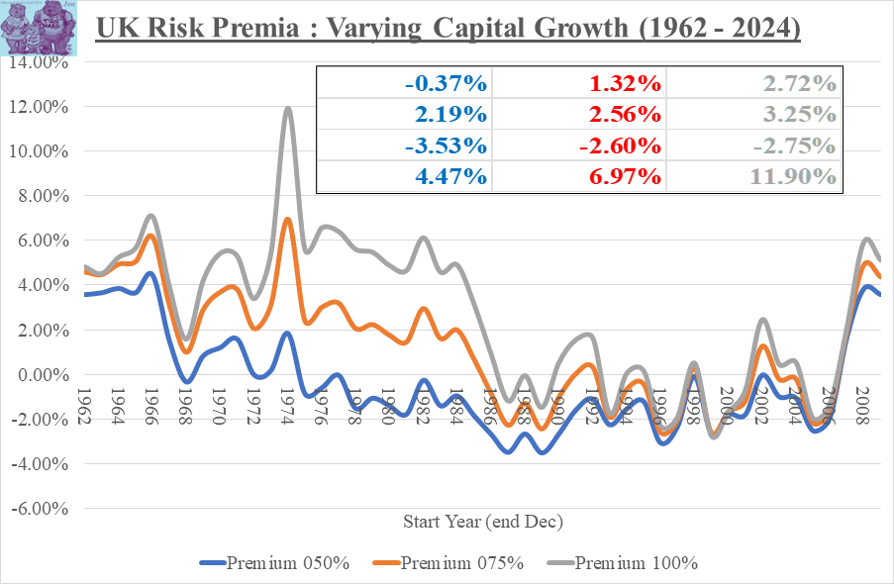


long-term risk premium 1962-2024

Slide 17
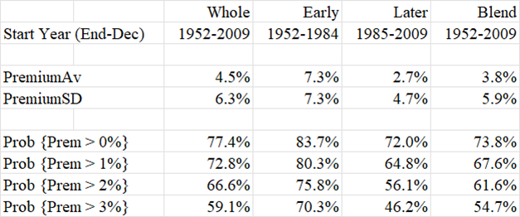
how likely is equity risk premium?
using 1,000 random numbers over 1952 to 2024
correlated UK return differences over 15 years
non-correlated figures thought to be similar

Slide 18
forecasting approaches
pick a number from the air
  “fudge, judge & bodge” (Staple Inn 25 October 1999)
look at what other actuaries do
  but how did they obtain their numbers?
“actuarial approaches” need to be more robust
we need to focus upon strategy rather than tactics
… so long as we credibly believe we have enough time
  say 15 years or longer
“off-market” is actuary's tool for soaking up volatility
  seeking long-term funding resilience

Slide 19
reflecting long-term reality
there IS one uniquely correct view of long-term future
… but we don’t know it, hence assumptions needed
  when? which way? how far? how long?
  no such thing as free lunch over time
long-term can imply different restraints
  can’t simultaneously aim “long” and “short”
“broadly right” better than “precisely wrong”
risk quantification “poorly” captured by single numbers
huge concentration on risk - without reward recognition
prudence only identifiable from best estimate

Slide 20
expected long-term returns (1 of 2)
how can we assess long-term discount rates?
  … which need to be consistent with returns
  … otherwise systematic bias introduced
  … which is the problem with accounting numbers
Pension Fund Valuations & Market Values WP
  report presented at Staple Inn 25 Oct 1999
Valuation Rates of Interest WP followed on
  from Jan 2003 until late 2004 (closed down peremptorily)
I was privileged to be a member of both WPs
  VRIWP agreed “multiple” approach had potential

Slide 21
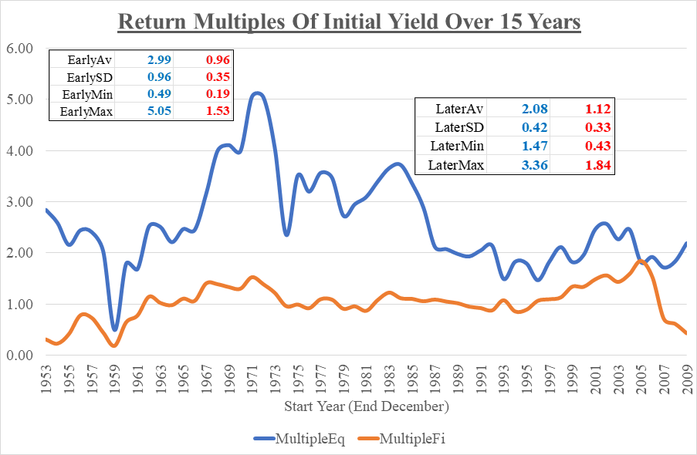

expected long-term returns (2 of 2)

Slide 22
simple financial contracts (1 of 6)
can we cope with simplicity in mark-to-market world?
new financial business being set up
  seeking best estimates WITHOUT formal guarantees
  guarantee costs rarely understood by consumers
two single-premium contracts (one pricing opportunity)
  term annuity (£1,000 pa in arrears) over 15 years (“inc”)
  pure endowment of £10,000 payable in 15 years (“cap”)
  payments either fixed or fully inflation-linked (RPI)
  {demographics, options, profits, tax, expenses} ignored
how much is initially needed to fund basic cashflows?

Slide 23
simple financial contracts (2 of 6)
6 different financials considered for UK alone
  end-December to end-December
  equities (“Equ”), conventional “(Fix”) & index-linked (“Ilg”)
  3 returns over 1 year and 3 yields
  2 inflation rates (over 1 year and over 15 years)
  UK RPI (longer true data series than for CPI or CPIH)
financials modelled annually from end-1953
  until end-2024
  further split into “early [<1985]” and “later [> 1984]”
  ILGs only available for “later” period
“blend” experience alone considered

Slide 24
simple financial contracts (3 of 6)
“blend” correlated results alone included until 2024
  non-correlated results thought to be similar (earlier work)
  experiences split into “whole”, “early”, “later”, “blend”
  “blend” is 80% “later” and 20% “early” by probability
1,000 scenarios (5% tails based on 50 cases)
financials not best modelled as Normal or log-Normal
  “near best fits” taken instead
  current financial conditions “lower than normal”
  random numbers used atypical of “now”
original 2017 DWP submission based upon end-2014

Slide 25
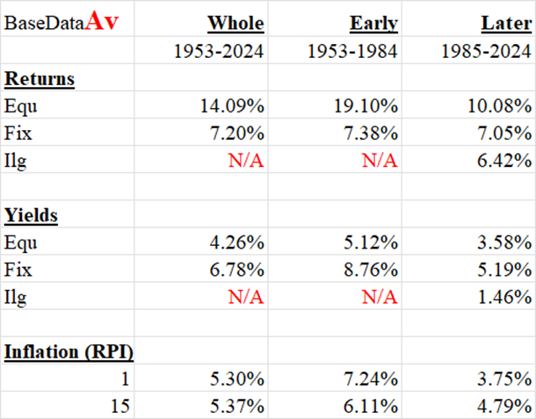
simple financial contracts (4 of 6)
return means over one year

Slide 26
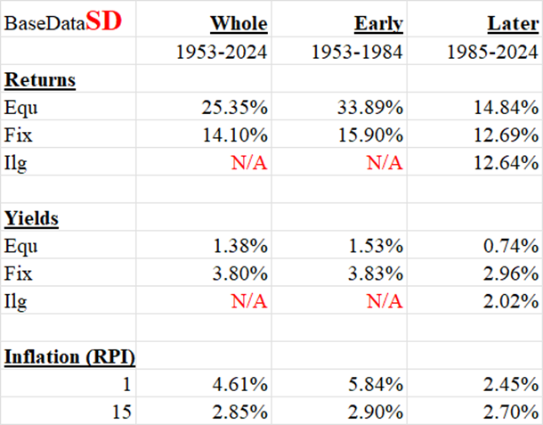
simple financial contracts (5 of 6)
return standard deviations over one year

Slide 27
simple financial contracts (6 of 6)
mark-to-market taken as implying “using gilt yields”
  based upon long conventional for fixed contracts
  based upon long index-linked for linked contracts
  ignoring intended investment policy (unlike off-market)
  simplistic but good enough
off-market allows longer-term approach
“off” assumed returns defined relative to initial yield
  equities * 2.52 (2.22 + 0.30 arbitrary)
  conventional gilts * 0.88 (1.08 – 0.20 arbitrary)
  index-linked gilts yield + expected RPI + 1%

Slide 28
links to online interactive charts
how far away from desired destination will we be?
how successful will either pricing approach be?
how likely is annuity fund to be exhausted early?
how excessively cautious was initial pricing?
how should we vary initial discount rate?

Slide 29
fund development (1 of 3)
consider fund development example
linked cash, conventional gilts, baseline MtM {Off}
blended random experience (“blend”)
mean end deflated fund value £11,198 {£23,523}
  mean opening fund £8,444 {£18,607}, both too high
adjusted MtM and Off (same cashflows)
  mean end fund value £10,000 (real terms)
  mean opening fund £9,666 {£9,666}, both just right
  required discount rate adjustments -0.31% {+0.55%}

Slide 30
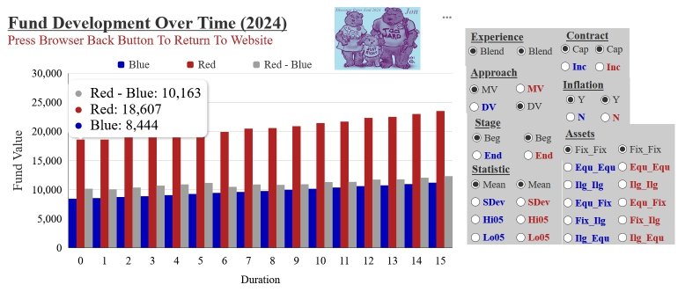
fund development (2 of 3)

Slide 31
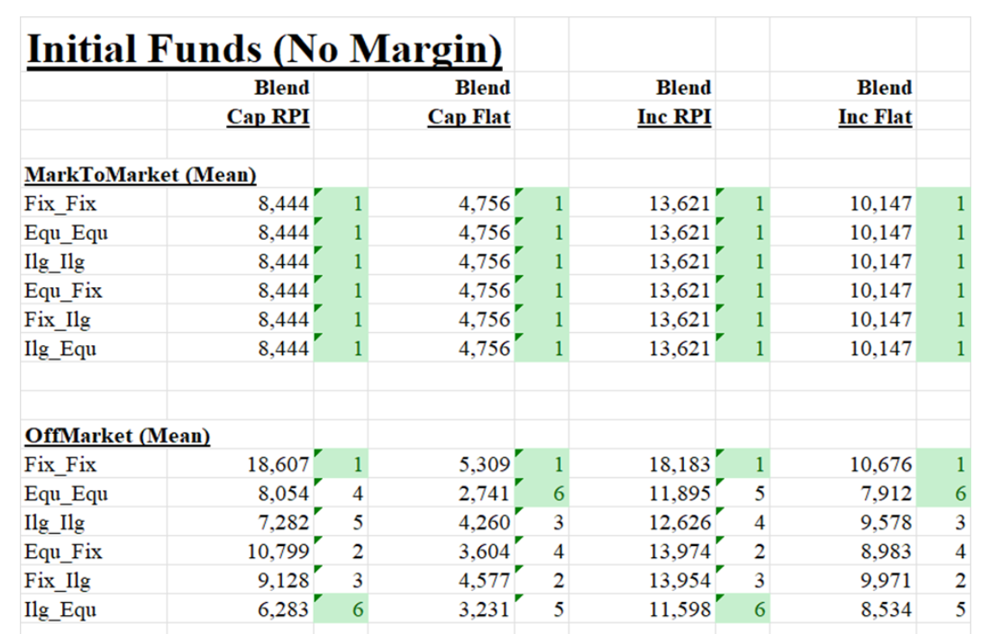
fund development (3 of 3)

Slide 32
end-contract assets adequacy (1 of 5)
how often will assets at end be adequate?
three situations considered:
  failure “Lo”
  acceptable (surplus no higher than £1,000 deflated) “OK”
  wasteful “Hi”
reducing acceptable margin will increase “Hi”
linked cash, “Fix”, “blend” (“MtM”, “Off”)
  Lo (mean) 53% 48%
  OK (mean) 5% 5%
  Hi (mean) 42% 47%

Slide 33
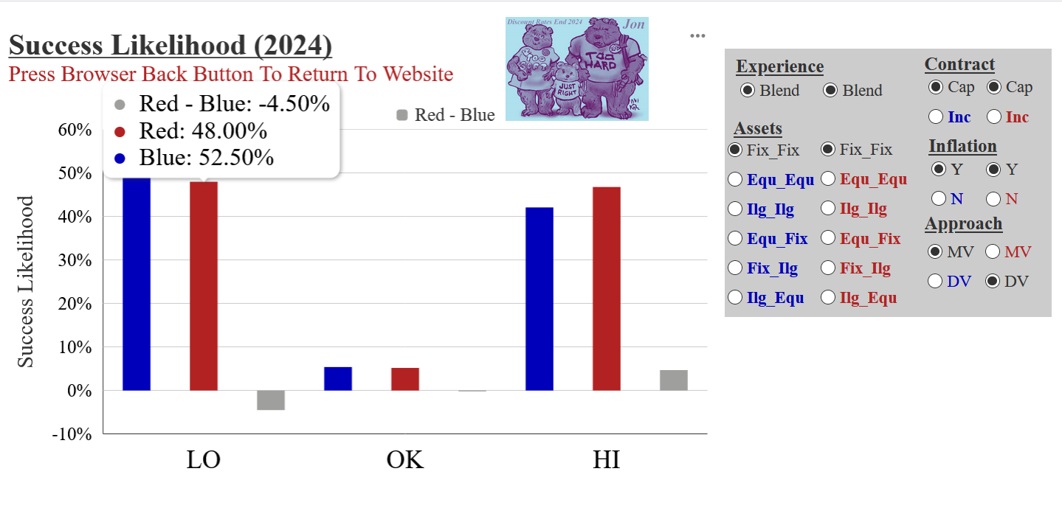
end-contract assets adequacy (2 of 5)

Slide 34
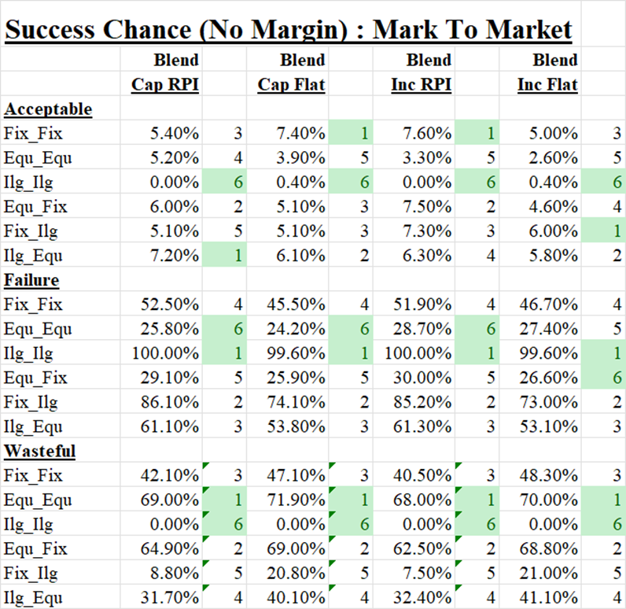
end-contract assets adequacy (3 of 5)

Slide 35
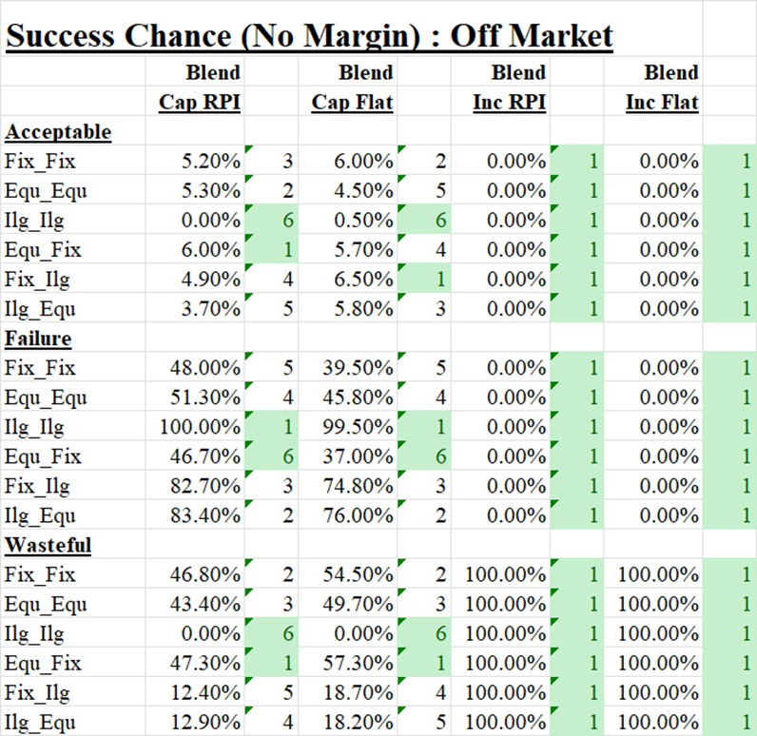
end-contract assets adequacy (4 of 5)

Slide 36
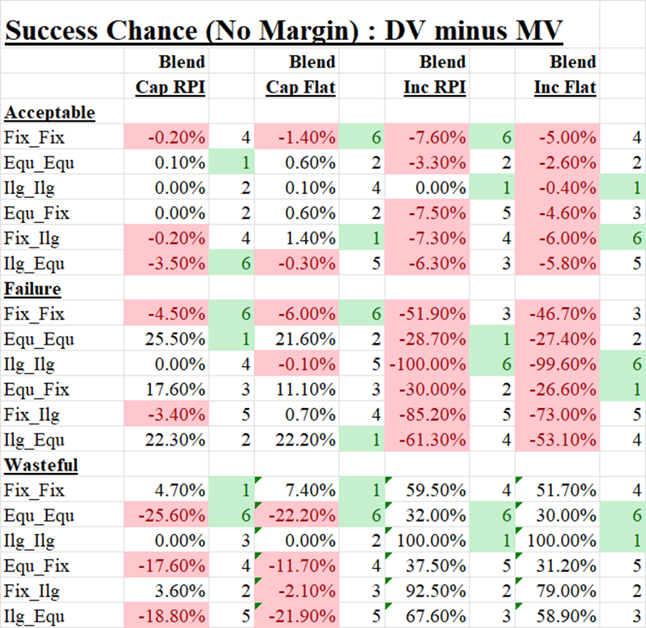
end-contract assets adequacy (5 of 5)

Slide 37
annuity failure likelihood (1 of 3)
how likely will annuity fund be insufficient over time?
  during annuity term (not quite same as previous section)
for cash, cash financial status only assessable at end
  just one benefits cashflow at end
linked annuity in “Fix”, “blend” (“MtM”, “Off”)
probability that assets insufficient at particular time
05 years 00.0% {0.0%}
10 years 12.4% {0.0%}
15 years 51.9% {0.0%}

Slide 38
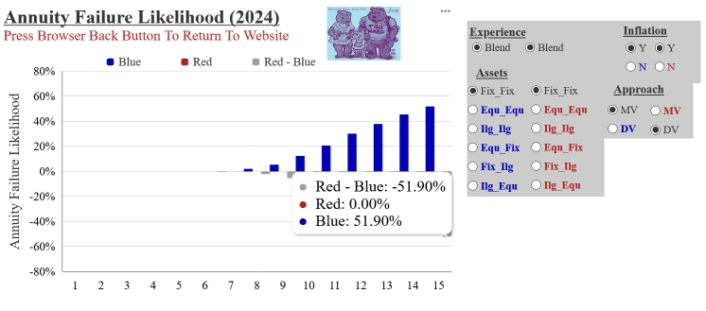
annuity failure likelihood (2 of 3)

Slide 39
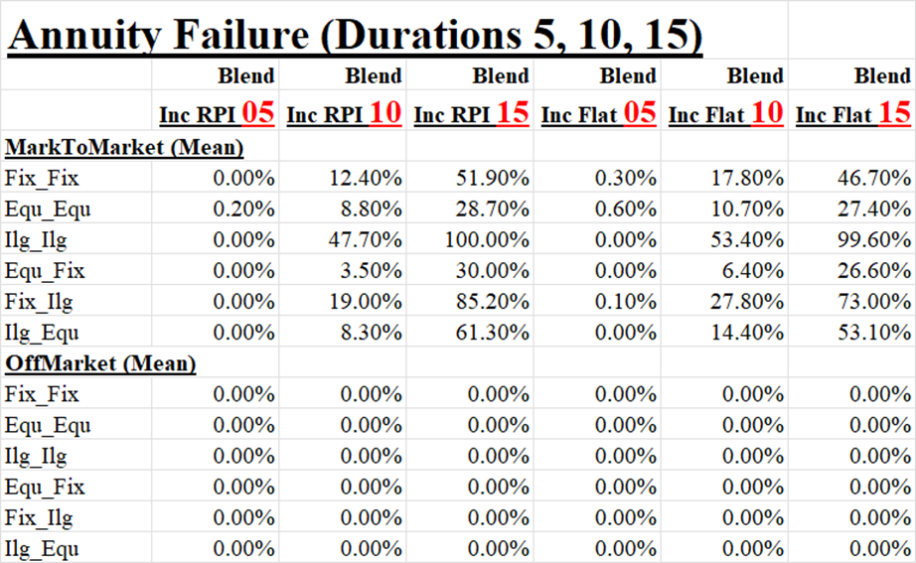
annuity failure likelihood (3 of 3)

Slide 40
mean relative caution (1 of 3)
how cautiously was initial premium set (as a ratio)?
linked cash, “Fix”, “blend” {“MtM”, “Off”}
mean of start fund values compared (initial to required)
  ratios now calculated in samples (previously estimated)
guess 08,444 {18,607} seen above
accurate 09,666 {09,666} seen above
caution ratio 0.87 {1.93} just an estimate
caution ratio 1.12 {2.35} calculated

Slide 41
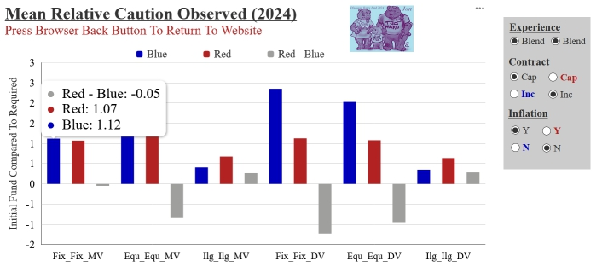
mean relative caution (2 of 4)

Slide 42
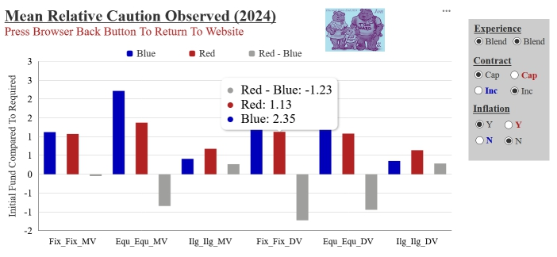
mean relative caution (3 of 4)

Slide 43
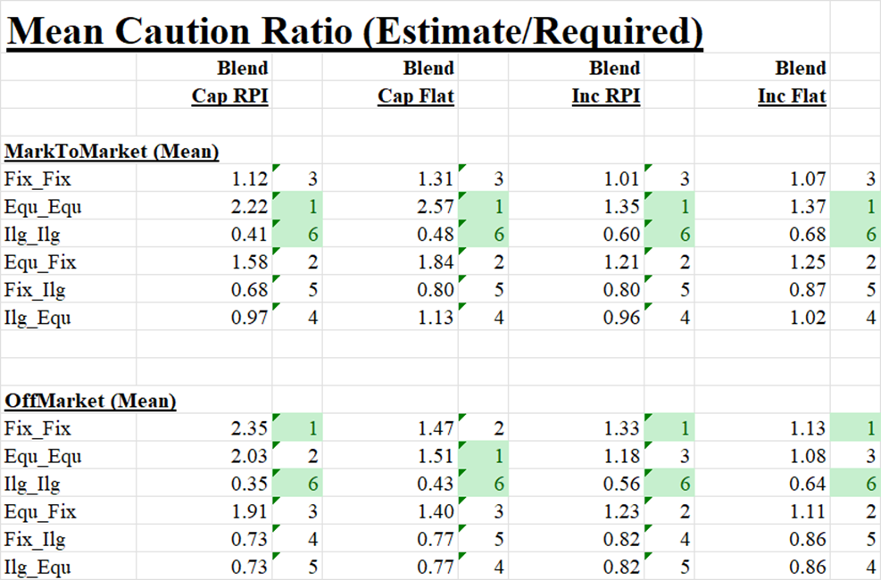
mean relative caution (4 of 4)

Slide 44
discount rate adjustments (1 of 6)
how far away from accurate was original discount rate?
linked cash in “Fix”, “blend” (“MtM”, “Off”)
discount rates compared
initial guess 1.46% {0.60%}
accurate 1.08% {1.08%} must be the same
adjustment -0.37% {0.48%}

Slide 45
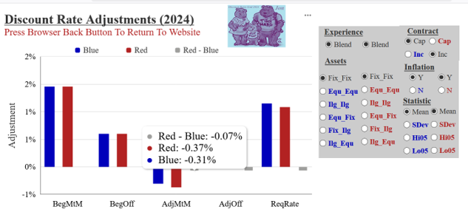
discount rate adjustments (2 of 6)

Slide 46
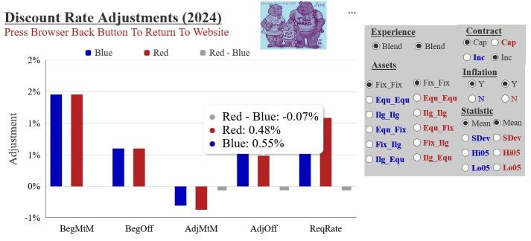
discount rate adjustments (3 of 6)

Slide 47
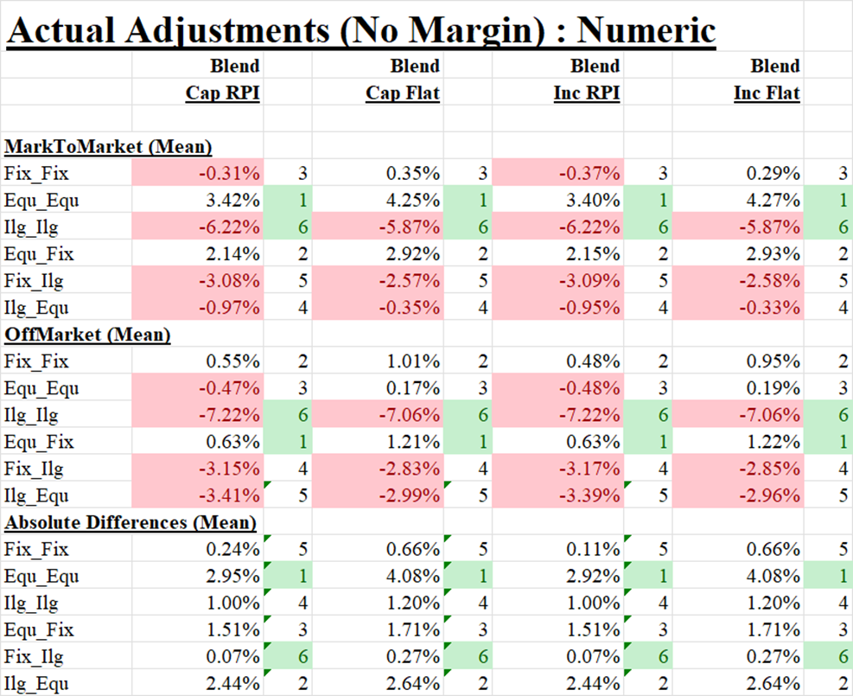
discount rate adjustments (4 of 6)

Slide 48
discount rate adjustments (5 of 6)
previously took account of numeric values alone
  maybe should be looking at absolute values instead?
  rationale that too far under is as bad as too far over
100 adjustment “random readings”, 50 -2 and 50 +2
mean is zero, apparently great result, not persuasive
  every single value nowhere near zero
example for equities (“cap”, “blend”, inflation-linked),
  numeric MtM mean 3.42%, numeric off mean -0.47%
  absolute MtM mean 5.19%, numeric off mean 5.71%)
using numeric values understates errors, not sole metric

Slide 49
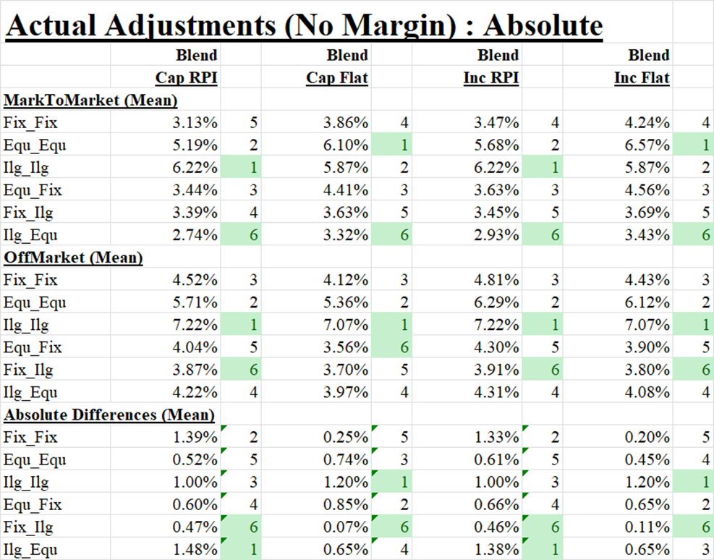
discount rate adjustments (6 of 6)

Slide 50
surplus refunds
recent moves to allow DB refunds (“drive UK growth”)
seen before, “excessive surpluses”, 1987 to 2004
  not all actuaries understood fairly simple rules in place
  GAD carried out 84 detailed inquiries for Inland Revenue
Feb 2025 ACA policy paper laid out seven key challenges
challenge [2] suggested that DB total remaining assets
  need high degree of confidence about full existing benefits
  essentially a probability, requiring stochastic process
If still a trustee, I’d demand robust stochastic evidence
  at sponsor’s expense

Slide 51
stop relying upon discount process
capitalisation was original actuarial tool
  all we had but no longer the only long-term tool available
  it hides far more than it reveals (“fake news”?)
discount rates are:
  simple and simplistic, leading to false certainty
  readily available to anyone
  dangerous in everybody’s hands
everyone should stop using discount rates alone
  for long-term projects with specified intended outcomes
  … because cashflows are the key elements (liquidity?)

Slide 52
key takeaways
following evidence is essential
today (or yesterday) doesn’t represent all we know
huge concentration on risk - without reward recognition
prudence only identifiable from best estimate
scalars useless for representing many future uncertainties
no illiquidity information (except at assumed final point)
£131b (private sector) misallocated in UK (15 years)
scheme assets fell from £1.7t (2021) to £1.2t (2024)
if we can’t do simple, can we really do complex?

