Slide 1
Discount Process Is The Problem
An “Off-Market Approach”
Jon Spain (12 Oct 2023)
www.discrate.com

Slide 2
agenda
my main points
disclaimer
why does this matter?
following evidence is essential
defining terms used
the long term – is there one? estimating returns?
single numbers presented as “results”
forecasting approaches
simple financial contracts
conclusions

Slide 3
my main points
we don’t know long-term future - we need assumptions
today doesn’t represent all we know
  we can look back at the past to see what we think happened
  we also need to be very careful about using the past
prudence only identifiable from best estimate
future complexity poorly captured by single numbers
… which is where discount process inexorably leads
appropriate discount rates are very hard to specify
… making discount process inappropriate for long-term
huge concentration on risk - without reward recognition

Slide 4
disclaimer
views expressed are entirely personal
thanks are due to those who discussed issues over time
… and to those who have refused to engage
in no way endorsed by UK actuarial profession - yet
actuaries claim to understand risks
  probabilities rarely (if ever) disclosed to DB pension clients
DB pension schemes tied to discounting
  required by regulators
  doesn’t mean discounting must be useful for long term
not criticising either scheme actuaries or regulator
  just framework within which they are forced to operate

Slide 5
why does this matter?
UK DB pension scheme funding inefficiently controlled
  insurance companies (life and general) quite different
data (April) below from Pensions Regulator Purple Book
  private sector DB pension schemes (not public sector)
in 2006, estimated 7,751 schemes (14.0 m members)
in 2021, estimated 5,220 schemes (9.7 m members)
in 2021, scheme assets still stood at £1.7 trillion
  even after many liability transfers during 15 years
  likely to be far lower now (£1.2 trillion?) after LDI crisis
required assets assessed under discount process
  … which is the underlying problem

Slide 6
following evidence is essential
actuaries (financial scientists) need to follow evidence
  always needs to be checked (complete? robust? …)
  no evidence that financial economics useful for long-term
evidence available must be interpreted - as experts
  otherwise, contributing very little indeed
interpretation is subjective, not objective
  room for expert judgment
nothing wrong with subjectivity, so long as …
  independent (not merely too common groupthink)
  cogently fully explained
  stakeholders empowered to understand potential outcomes

Slide 7
what is discount process?
discounting principle known for over 2 millennia
  only adopted for longer-term finance in late 18th century
suppose precise return of 3 % pa for next year is certain
  103 due in a year’s time can be financed by initial 100
converting future cashflows to present
  discount rate inverse of investment return, not just abstract
  used by actuaries, accountants, project managers, scammers
we don't live in such a secure financial environment
  lack of certainty, much longer periods, assets not just cash
future unknowable => no uniquely correct discount rate
  liquidity problems not identifiable in advance

Slide 8
what is “mark-to-market” (MtM)?
“realistic appraisal of current financial situation”
market may sometimes appear illogical
… implying that opportunities exist for profits
markets are run by traders
  traders decide where THEY want to be (pricing) NOW
long-term funding depends upon long-term future
  if there is one (always needs to be considered)
many possible alternatives (labelled “off-market”)
why sub-contract L-T assumptions to S-T traders?

Slide 9
is there a long-term?
predators exist
  private (internal or external)
  public (regulators)
how much long-term confidence can there be?
  for trustees, members, sponsors, policyholders …
essential for issues to be discussed in depth
stakeholders entitled to follow own views
crucial that agreed approaches are fully documented
  do “SIP” and “SFP” really cover long-term issues (DB)?
equity risk premia (history and likelihood)

Slide 10
long-term risk premia
over rolling periods of 15 years
mean equity return minus mean bond return
equity return partly capital and partly income
  long-term equity return components
  long-term risk premium history
  likelihood of equity risk premium (random numbers)
  long-term premia (adjusted for capital growth)

Slide 11
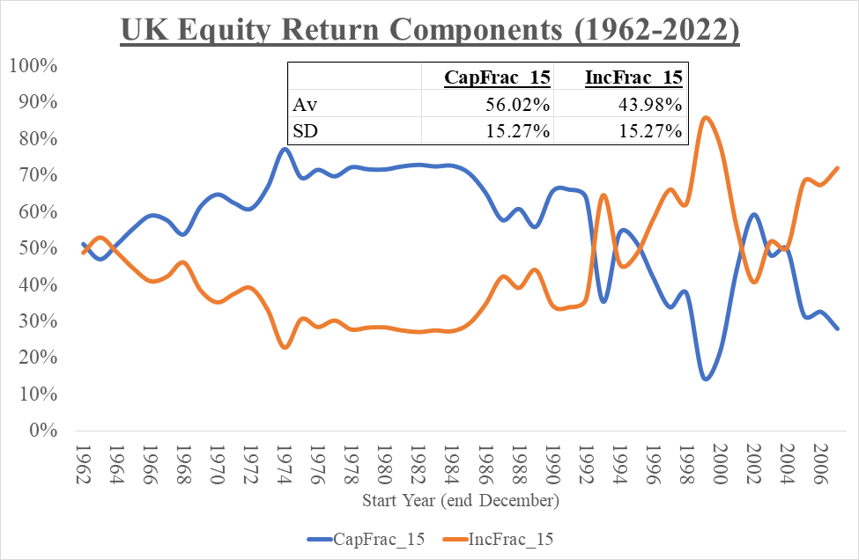
UK equity return components
periods of 15 years (data 1962 to 2022)

Slide 12
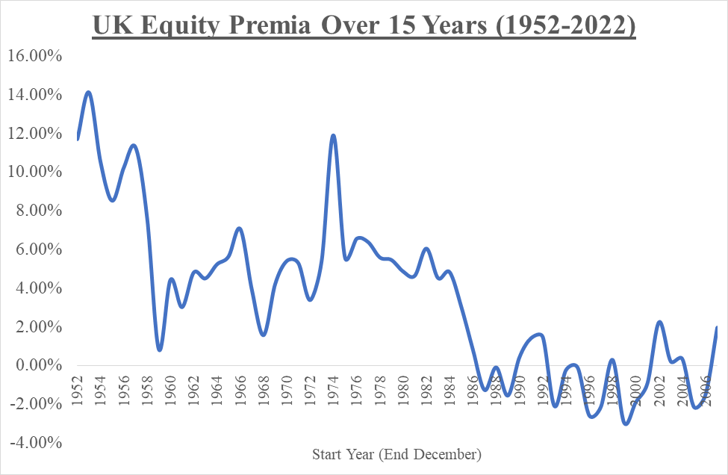


long-term risk premium 1952-2022

Slide 13
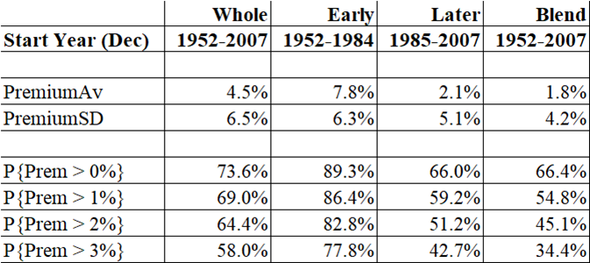
how likely is equity risk premium?
using 1,000 random numbers over 1952 to 2021
correlated UK return differences over 15 years
non-correlated figures thought to be similar

Slide 14
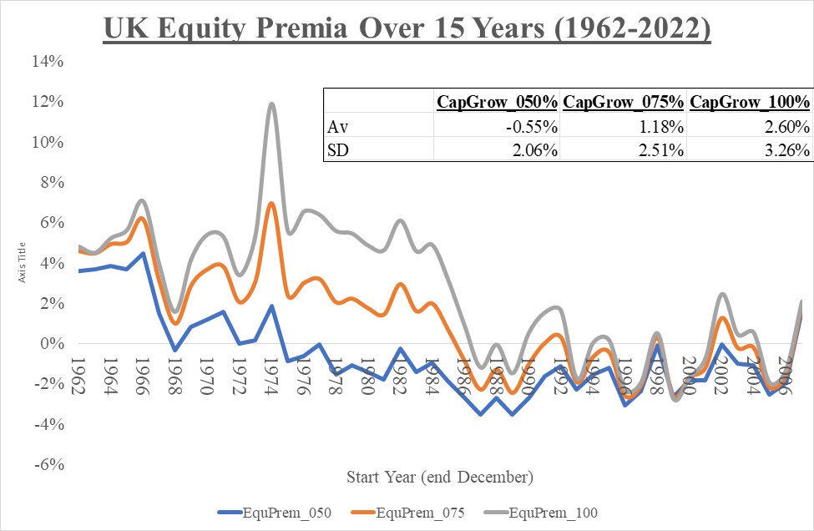

long-term risk premium 1962-2022

Slide 15
base data (1 of 2)
6 different financials considered for UK alone
  end-December to end-December
  equities and conventional gilts
  2 returns over 1 year and 2 yields
  2 inflation rates (over 1 year and over 15 years)
  UK RPI (longer true data series than for CPI or CPIH)
financials modelled annually from end-1953
  until end-2022
  further split into “early [<1985]” and “later [> 1984]”
I decided to exclude ILGs (only available for “later”)

Slide 16
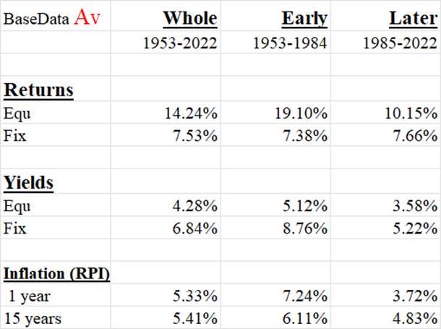
base data (2 of 2)

Slide 17
random numbers on website
correlated results alone included until 2022
  non-correlated results thought to be similar (earlier work)
  experiences split into “whole”, “early”, “later”, “blend”
  “blend” is 80% later and 20% “early” by probability
1,000 scenarios (5 in 100 based on 50 cases)
financials not best modelled as Normal or log-Normal
  “near best fits” taken instead
  current financial conditions “lower than normal”
  random numbers used atypical of “now”
original 2017 DWP submission based upon end-2014

Slide 18
expected long-term returns (1 of 2)
how can we assess long-term discount rates?
  … which need to be consistent with returns
  … otherwise systematic bias introduced
  … which is the problem with accounting numbers
Pension Fund Valuations & Market Values WP
  report presented at Staple Inn 25 Oct 1999
Valuation Rates of Interest WP followed on
  from Jan 2003 until late 2004 (closed down peremptorily)
I was privileged to be a member of both WPs
  VRIWP agreed “multiple” approach had potential

Slide 19
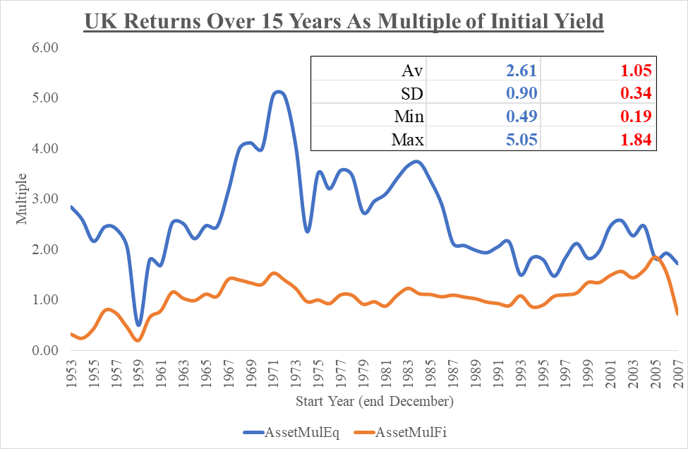

expected long-term returns (2 of 2)

Slide 20
single numbers presented as “results”
single numbers are not appropriate results
… for representing many future uncertainties
  NYU Stern (1977) & Z/Yen (2012)
  Simon Carne’s SIAS paper (2004)
especially when single number never fully specified
  mean? median? mode? specified percentile?
we should be looking at multi-dimensional results
  with confidence intervals (deterministic approach fails)
  aiming at avoiding “fog of certainty” (actuarial noise)
  being able to recognise lack of liquidity in advance

Slide 21
reflecting long-term reality
there IS one uniquely correct view of long-term future
… but we don’t know it, hence assumptions needed
  when? which way? how far? how long?
  no such thing as free lunch over time
long-term can imply different restraints
  can’t simultaneously aim “long” and “short”
“broadly right” better than “precisely wrong”
risk quantification poorly captured by single numbers
huge concentration on risk - without reward recognition
prudence only identifiable from best estimate

Slide 22
forecasting approaches
pick a number from the air
  “fudge, judge & bodge” (Staple Inn 25 October 1999)
look at what other actuaries do
  but how did they obtain their numbers?
“actuarial approaches” need to be more robust
we need to focus upon strategy rather than tactics
… so long as we credibly believe we have enough time
  say 15 years or longer
“off-market” is actuary's tool for soaking up volatility
  seeking long-term funding resilience

Slide 23
simple financial contracts (1 of 15)
can we cope with simplicity in mark-to-market world?
new financial business being set up
  seeking best estimates WITHOUT formal guarantees
  guarantee costs rarely understood by consumers
two single-premium contracts (one pricing opportunity)
  term annuity (£1,000 pa in arrears) over 15 years (“inc”)
  pure endowment of £10,000 payable in 15 years (“cap”)
  payments either fixed or fully inflation-linked (RPI)
  allow later for demographics, options, profits, tax, expenses
how much is initially needed to fund basic cashflows?

Slide 24
simple financial contracts (2 of 15)
mark-to-market taken as implying “using gilt yields”
  based upon long conventional
  same inflation estimate used as for off-market
  plus either 0% pa or 1% pa
  simplistic but good enough
off-market allows longer-term approach
  aligned to intended investment policy

Slide 25
simple financial contracts (3 of 15)
topics explored
how far away from desired destination will we be?
how successful will either pricing approach be?
how likely is the annuity fund to be exhausted?
how excessively cautious was initial pricing?
how should we vary initial discount rate?

Slide 26
simple financial contracts (4 of 15)
3 assets portfolios
  conventional gilts alone (“Fix”)
  equities alone (“Equ”)
  plus 50:50 combination
“off” assumed returns defined as multiple of initial yield
  equities 2.61(W) 2.99(E) 2.09(L) 2.27(B)
  conventional gilts 1.05(W) 0.87(E) 1.28(L) 1.20(B)
  standing for “whole”, “early”, “later “blend”
  actual mean experience (could use random distribution)
  originally used 3.00/1.25
  further multiplied by 80% OR 100% OR 120%

Slide 27
simple financial contracts (5 of 15)
consider fund development example
inflation-linked pure endowment for term 15 years
invested in conventional gilts, baseline MtM {Off}
blended random experience (“blend”)
mean end fund value £21,141 {£18,477}
  mean opening fund £11,237 {£9,834}, both too high
adjusted MtM and Off (same cashflows)
  mean end fund value £10,000 (real terms)
  mean opening fund £7,601 {£7,601}, both just right
  required discount rate adjustments 1.80% {0.64%}

Slide 28
simple financial contracts (6 of 15)
fund development chart
See chart at this link.

Slide 29
simple financial contracts (7 of 15)
how often will assets at end be sufficient?
three situations considered:
  not enough “Lo”
  acceptable (surplus no higher than £1,000 deflated) “OK”
  far too much “Hi”
reducing acceptable margin will increase “Hi”
linked endowment in “Fix”, “blend” (“MtM”, “Off”)
  Lo (mean) 39% 46%
  OK (mean) 5% 4%
  Hi (mean) 56% 50%

Slide 30
simple financial contracts (8 of 15)
success likelihood chart
See chart at this link.

Slide 31
simple financial contracts (9 of 15)
how likely will annuity fund be insufficient over time?
endowment financial status only assessable at end
  just one cashflow at end
linked annuity in “Fix”, “blend” (“MtM”, “Off”)
probability that assets insufficient at particular time
05 years 0.1% {0.3%}
10 years 3.3% {7.7%}
15 years 14.4% {18.3%}

Slide 32
simple financial contracts (10 of 15)
annuity fund exhaustion chart
See chart at this link.

Slide 33
simple financial contracts (11 of 15)
how cautiously was initial premium set?
linked endowment in “Fix”, “blend” (“MtM”, “Off”)
mean fund values compared
  ratios not originally calculated
guess 11,237 {09,834} seen above
accurate 07,601 {07,601} seen above
caution ratio 1.48 {1.29}

Slide 34
simple financial contracts (12 of 15)
excessive caution chart
See chart at this link.

Slide 35
simple financial contracts (13 of 15)
how far away from accurate was original discount rate?
linked endowment in “Fix”, “blend” (“MtM”, “Off”)
discount rates compared
guess 1.53% {2.69%}
accurate 3.34% {3.34%} must be the same
adjustment 1.80% {0.34%}
more examples on next two slides
See adjustments chart at this link

Slide 36
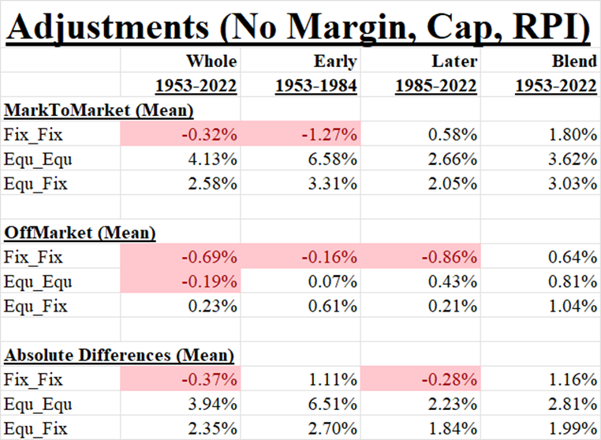
simple financial contracts (14 of 15)

Slide 37
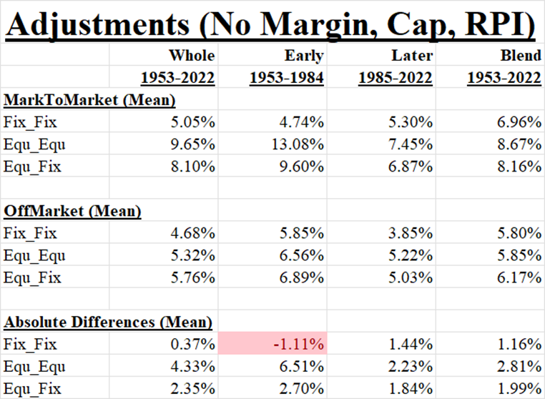
simple financial contracts (15 of 15)

Slide 38
hugely severe DB economic impact
how could we even have guessed how much in advance?
UK DB employers’ contributions (private sector alone)
  13 years [2009/Q2– 2023/Q1, 2 quarters missing] {ONS}
  total paid £419.6 b (special £189.4 b, 82% of normal)
suppose discount rate under-estimated by 1.5 % pa (mix)
  can easily reach 1.0 % pa from inflation (ukrpi.com)
implies at least 30% difference in capital value
so at least £126 b (private sector) misallocated in UK
  my personal estimate (MQ5 series has been replaced)
  choose your own yield adjustment

Slide 39
stop relying upon discount process
capitalisation was original actuarial tool
  all we had but no longer the only long-term tool available
  it hides far more than it reveals (“fake news”?)
discount rates are:
  simple and simplistic, leading to false certainty
  readily available to anyone
  dangerous in everybody’s hands
everyone should stop using discount rates alone
  for long-term projects with specified intended outcomes
  … because cashflows are the key elements (liquidity?)
  if we can’t do simple, can we really do complex?

